Slide 1
Customer Creditworthiness Analysis
Data Analytics Phase

Slide 2
Objective
Problem Statement
The objective of this machine learning project in the banking domain is to build a predictive model using historical banking data. The model aims to assist bank employees in efficiently and accurately determining suitable candidates for loan approval.
Develop a machine learning solution for the banking domain that automates and accelerates the loan approval process by effectively filtering and identifying suitable candidates from a high volume of loan applications. The current manual review process is time-consuming and inefficient, hindering the productivity of bank employees. By leveraging the available banking data, the goal is to create a model that accurately predicts the approval status of loan applications, enabling the bank to streamline operations, reduce processing time, and make more informed decisions regarding loan approvals.

Slide 3
Data Dictionary
Loan_ID: Unique Loan ID issued on every loan for a applicant
Gender: Gender of a applicant whether male or female
Married: Marital status of a applicant i.e., Yes for married and NO for single
Dependents: Number of individuals who are financially dependent on applicant
Education: Highest Education of applicant i.e, Bachelor, Post Graduation etc
Self_employed: Whether the applicant is self employed or not i.e, Yes for self employed or else NO
Applicant Income: Income of the applicant
Co-Applicant Income: Applicant have to put one nominee name that is called Co-Applicant. So, it is column related to co-applicant income, dtype: Integer.
Loan Amount: Amount of loan applicant wants to issue from the bank.
Loan_Amount_Term: The amount of time the lender gives you to repay your whole loan, dtype: float.
Credit_History: It tells about the credit done in the past by the applicant, dtype: Integer.
Property_Area: This tells about the applicant property is in which area i.e., Rural or Urban, dtype: String.
Loan_status: It is a target variable column which tells about whether the applicant application for loan approval is passed or not, dtype: String.

Slide 4
Workflow
Domain study
Business impact
Model Evaluation
Data Quality Check
Parameter tuning,
Selecting the best model
Cleaning missing values and looking for irregularities
Exploratory Data Analysis
Model Building
Around the prepped data, we shall build a prediction model
Checking Hypothesis,
Feature Importance analysis

Slide 5
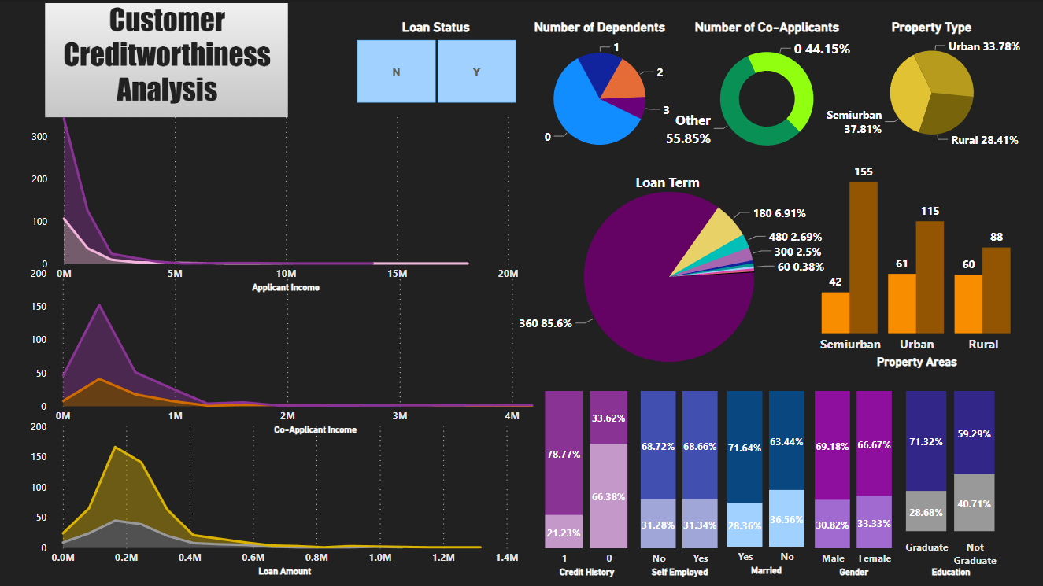
Key Insights

Slide 6
Assessing the Impact of every Feature on the Target Variable

Slide 7
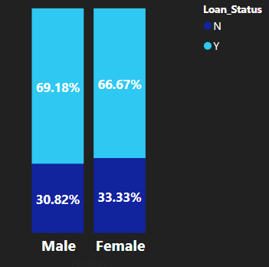
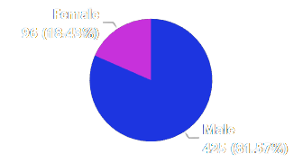
Gender
The number of Female applicants is almost one fourth that of the number of Male applicants
However, there seems not much difference in the percent of loans approved if we consider Gender
Hypothesis : Gender may have a potential impact, considering that in some cases there are Gender based incentives.

Slide 8
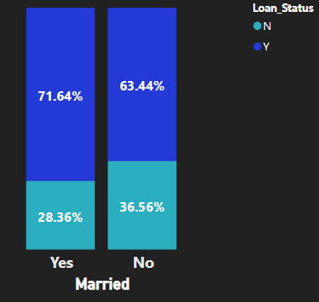
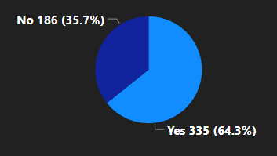
Marital Status
Chances of loan approval are very slightly more in case of married applicants
64% of the applicants are married
Hypothesis : Income and debt of both applicants can be considered while assessing credibility. Some lenders could consider married applicants financially stable

Slide 9
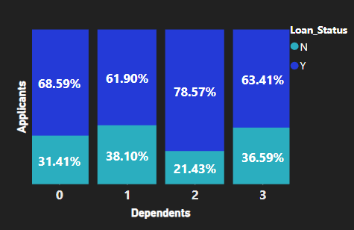
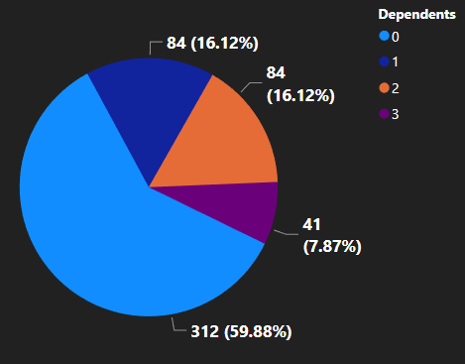
Number of Dependents
The number of applicants with 0 dependents are the highest
However, there isn’t a definitive difference in the category wise percentage approval of loans
Hypothesis :The number of dependents an applicant has may influence their ability to repay the loan. More dependents could indicate a higher financial burden, which might affect loan approval.

Slide 10
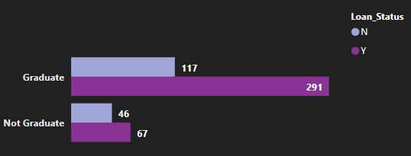
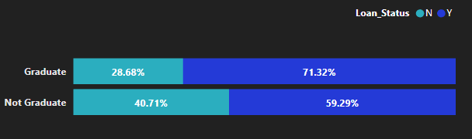
Education
Majority of the applicants are Graduates
In line with our hypothesis, graduates have slightly more percentage approved loans than non graduates
Hypothesis: The educational background might impact loan approval. Some lenders may prioritize applicants with higher education as they might be perceived to have better job prospects or financial stability

Slide 11
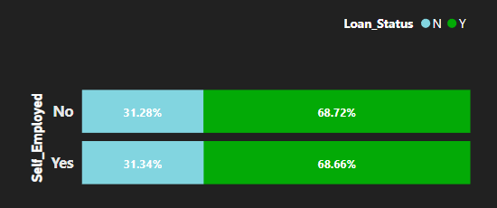
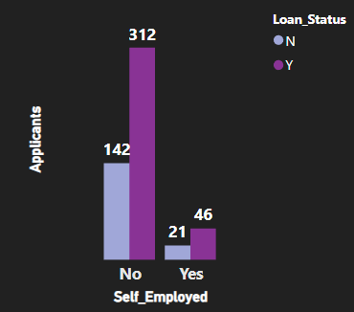
Self Employment
Number of applicants not self employed are significantly more than applicants who are self employed
However, the approval and rejection percentage of either self employed or not self employed is almost the same
Hypothesis: Being self-employed could potentially affect loan approval, as it may involve more irregular income or higher perceived risk as compared to individuals with jobs.

Slide 12
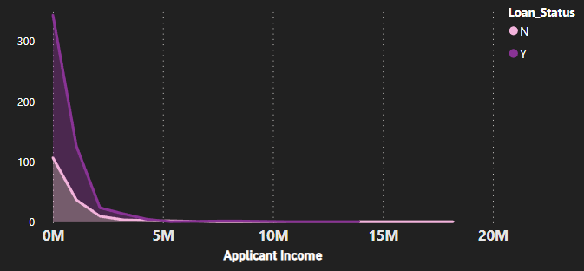
Applicant Income
However, loan applications of a few applicants having an income of even up to 15M have been rejected
Maximum applicants have an income below 5M, many of whose loans have been approved.
Hypothesis: Higher income levels generally indicate a greater ability to repay the loan. Thus, more credibility an higher chances of loan approval.

Slide 13
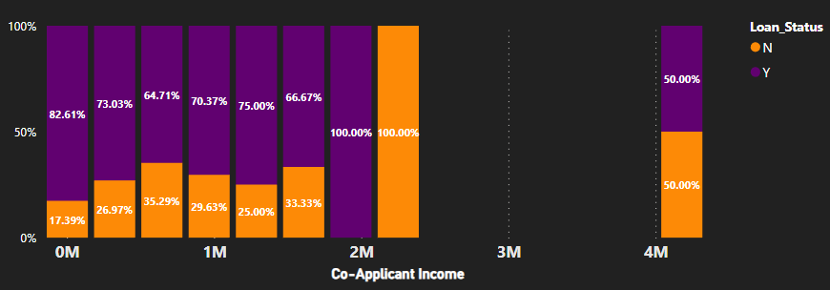
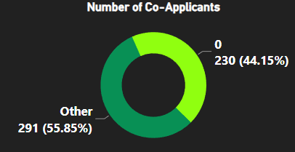
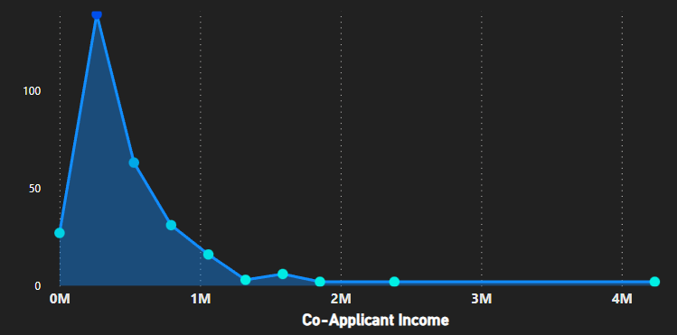
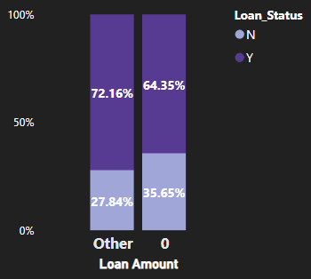
Co-Applicant Income
An average of 71% loans are approved for income below 2M
44% of applicants
do not have co-applicants
Maximum co-applicants have income less than 1M
Comparatively there is a very slight difference in the loan approval percentage for applicants with
co - applicants
Hypothesis: The income of the co-applicant, if applicable, can also impact loan approval. Combining the income of both the applicant and co-applicant can enhance the overall repayment capacity.

Slide 14
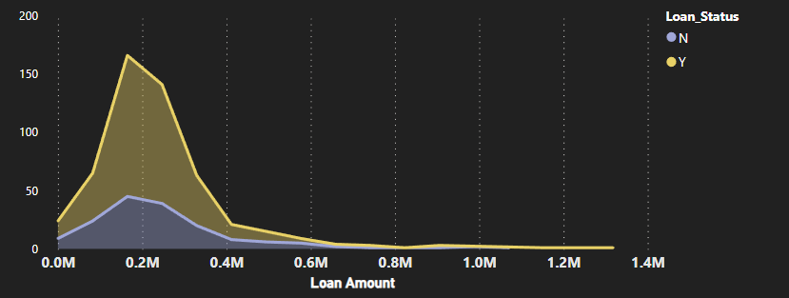
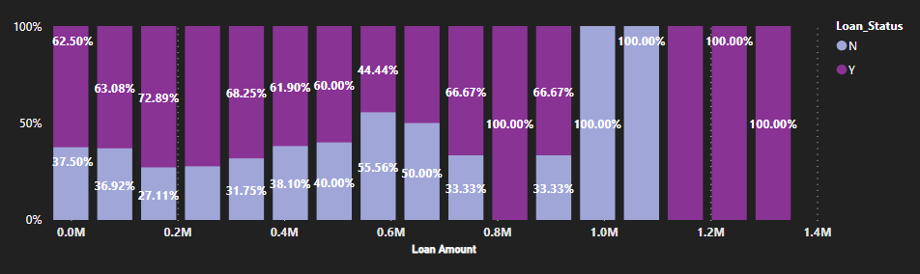
Loan Amount
Maximum applicants have requested a loan amount below the range of 0.6M with an approximate average approval rate of 63.71%
Some loans requested above 1.2M have been approved even with the high risk factor
Hypothesis: The loan amount requested by the applicant is an essential factor in loan approval. Higher loan amounts may involve greater risk or stricter assessment criteria.

Slide 15
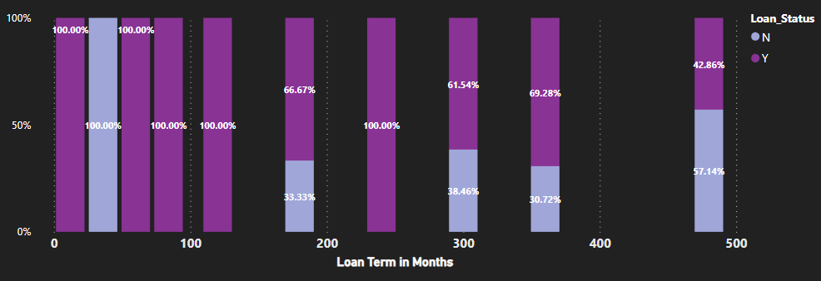
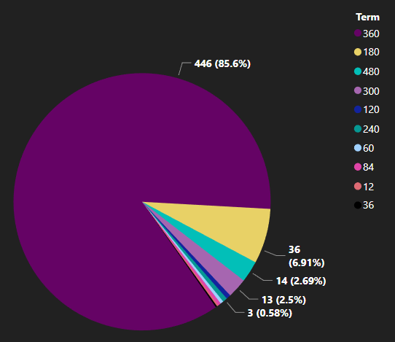
Loan Amount Term
Acceptance rate of applications is more where term is less than 400 months
85% of applicants have a Term of 360 months
Hypothesis: Longer-term loans may have different approval criteria or considerations compared to shorter-term loans.

Slide 16
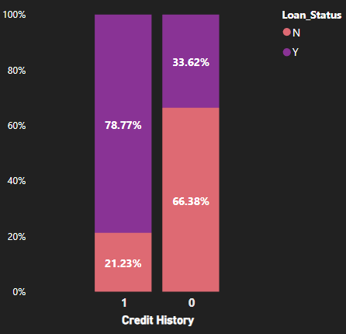
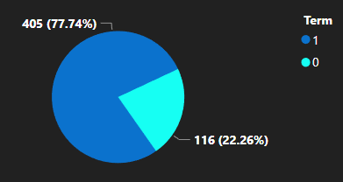
Credit History
Approximately 77% of the applicants do have a credit history
Applicants having a credit history have 45% more chance of having their loan approved
Hypothesis: The Credit history is a critical factor in loan approval. It indicates the applicant's past repayment behaviour and creditworthiness.

Slide 17
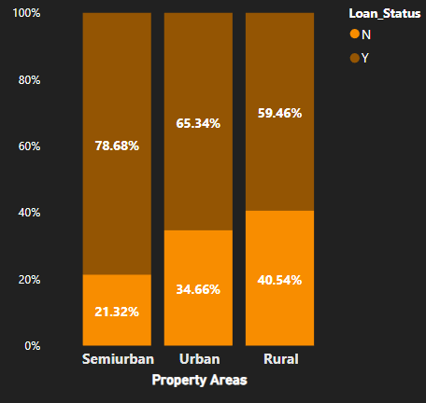
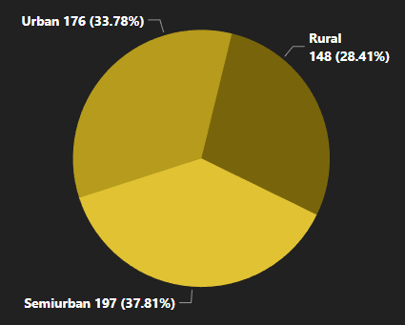
Property Type
The Semi Urban property type applications have more approval percentage for loans
Maximum property types are Semi Urban
Hypothesis: Different property areas may have varying market conditions, risks, or loan programs. Therefore, affecting the loan approval process

Slide 18
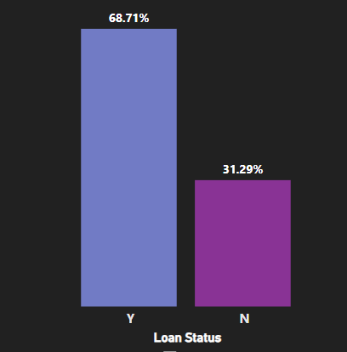
Loan Status
Approved Loans are almost 37% more than not approved loans

Slide 19
MultiVariate
Analysis

Slide 20
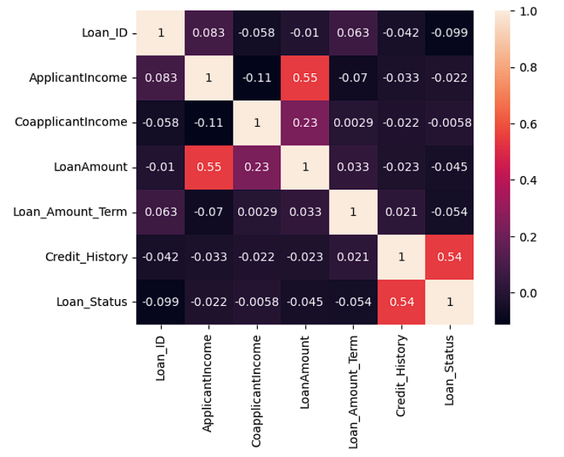
Loan Status
Applicant income is significantly positively correlated to the Loan Amount
Co-Applicant income is also slightly positively correlated to Loan Amount
Credit History is the only feature having direct and positive correlation with the Loan Status which is the Target variable

Slide 21
Conclusions
Gender of the applicant does not impact the loan approval process
Chances of loan approval for married applicants are 7% more than unmarried applicants
There isn’t a conclusive difference in the loan approval for the number of dependents affecting the loan status.
In line with the hypothesis, graduates have higher percentage of approved loans than non graduates
The employment status (whether self employed or not) does not affect the loan status
Applicant income does not affect loan status directly
Chances of loan approval are slightly more with a co-applicant present
Applications with a lesser loan amount have more chance of approval
Acceptance rate of applications is more where term is less than 400 months
Applicants having a credit history have 45% more chance of having their loan approved
The Semi Urban property type applications have highest approval percentage for loans
Applicant income is significantly positively correlated to the Loan Amount
Co-Applicant income is also slightly positively correlated to Loan Amount
Credit History is the only feature having direct and positive correlation with the Loan Status which is the Target variable

Slide 22
Thank You

